Slide 1





PRESENTATION 2026
Edu Pulse AI: Turning Student Voices into Institutional Growth
Faculty Name
Uma Maheshwari mam
Poonam.pragya11@gmail.com
Poonam Sharma

Slide 2

Outline
Abstract of the Project
Problem Statement
Proposed Solution
System Architecture
Live Demo of the Project
Embedded Video of Project
Conclusion
Future Scope

Slide 3
Abstract
Edu Pulse AI is an AI-based project that analyzes student feedback to improve teaching quality and institutional performance. It uses Power BI, Copilot, and AI Chatbot to perform sentiment analysis, identify trends, and generate actionable insights. Interactive dashboards and AI recommendations help in data-driven decision-making, making the system efficient and scalable for educational institutions.
The platform provides interactive dashboards that visually represent student satisfaction levels, faculty performance, and areas requiring improvement. AI-driven recommendations assist educators and administrators in making informed, data-driven decisions, ultimately enhancing teaching methodologies and learning outcomes.

Slide 4

Problem Statement
Student feedback in educational institutions is often unstructured and underutilized, making it difficult to extract meaningful insights. This affects faculty improvement and decision-making.
Existing tools provide limited analysis and lack AI-based insights.
This project focuses on analyzing feedback using Power BI, Copilot, and AI Chatbot to generate actionable insights, but does not include real-time or predictive analysis.

Slide 5

Proposed Solution
Edu Pulse AI is an AI-based system that transforms student feedback into actionable insights using Power BI, Copilot, and AI Chatbot.
It collects and cleEdans feedback data, then applies sentiment analysis and AI techniques to identify trends and improvement areas.
Interactive dashboards provide faculty comparison, sentiment trends, and data-driven recommendations.
The system offers multilingual analysis, AI-generated suggestions, and better decision-making, helping improve teaching quality and student satisfaction.

Slide 6
System Architecture
Data Input / Source
Processing / Analysis
The system collects data from multiple sources including raw files, databases, APIs, and user uploads. Raw data is gathered from Excel, CSV files, and Google Form responses containing student ratings and feedback comments. Historical feedback can be extracted from institutional databases or Learning Management Systems (LMS). Data can also be retrieved using APIs such as Google Forms or Microsoft Forms for automated updates. Additionally, manual uploads of institutional or simulated datasets are supported. The collected data is then processed using Excel, Power Query, and Power BI for further analysis.
The collected data is cleaned and transformed using Power Query in Excel and Power BI. Text feedback is analyzed using AI-based sentiment analysis, keyword extraction, and topic modeling to identify trends and student concerns. The processed data is then used to generate insights, recommendations, and interactive dashboards for teaching improvement.
AI / Tool Integration
Output / Dashboard
Excel is used to collect and organize student feedback data. Power Query is applied for data cleaning and transformation. Power BI is used to create interactive dashboards and visualize sentiment trends, comparisons, and insights. Microsoft Copilot / AI Chatbot is integrated to perform sentiment analysis, generate faculty-specific recommendations, and summarize student feedback. This integration enables automated analysis and data-driven decision-making for teaching improvement.
The final output is an interactive Power BI dashboard displaying key insights from student feedback. It includes sentiment analysis charts, faculty comparison graphs, trend analysis, and keyword-based insights. The dashboard also provides actionable recommendations and summary reports for faculty and academic leaders, enabling data-driven decisions for teaching improvement and institutional growth.

Slide 7
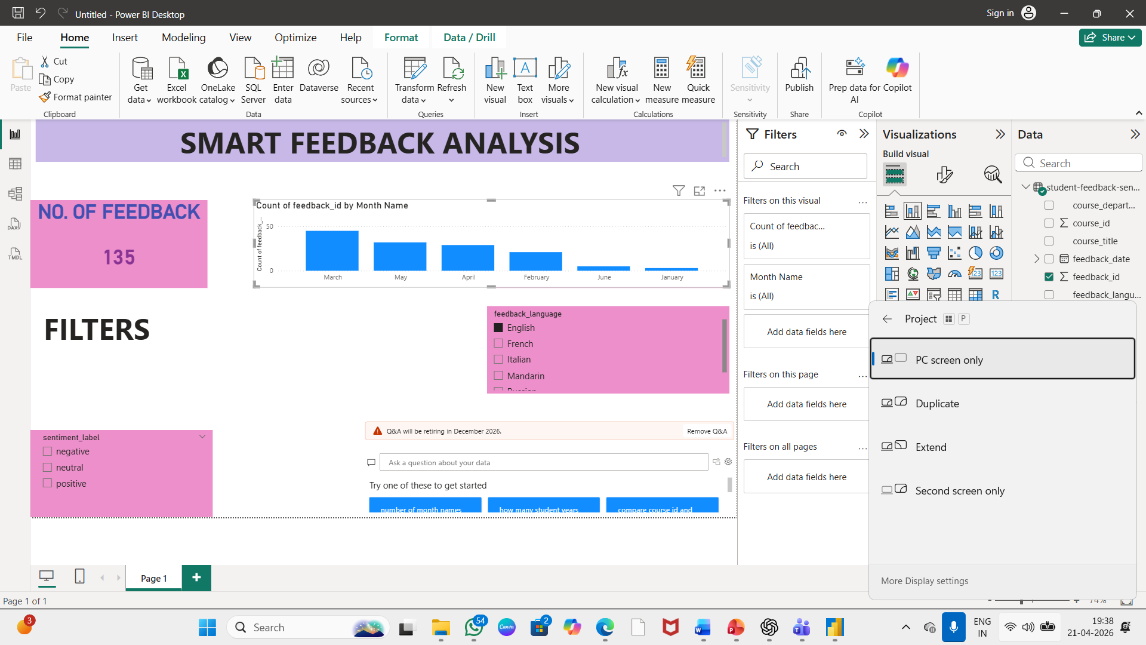
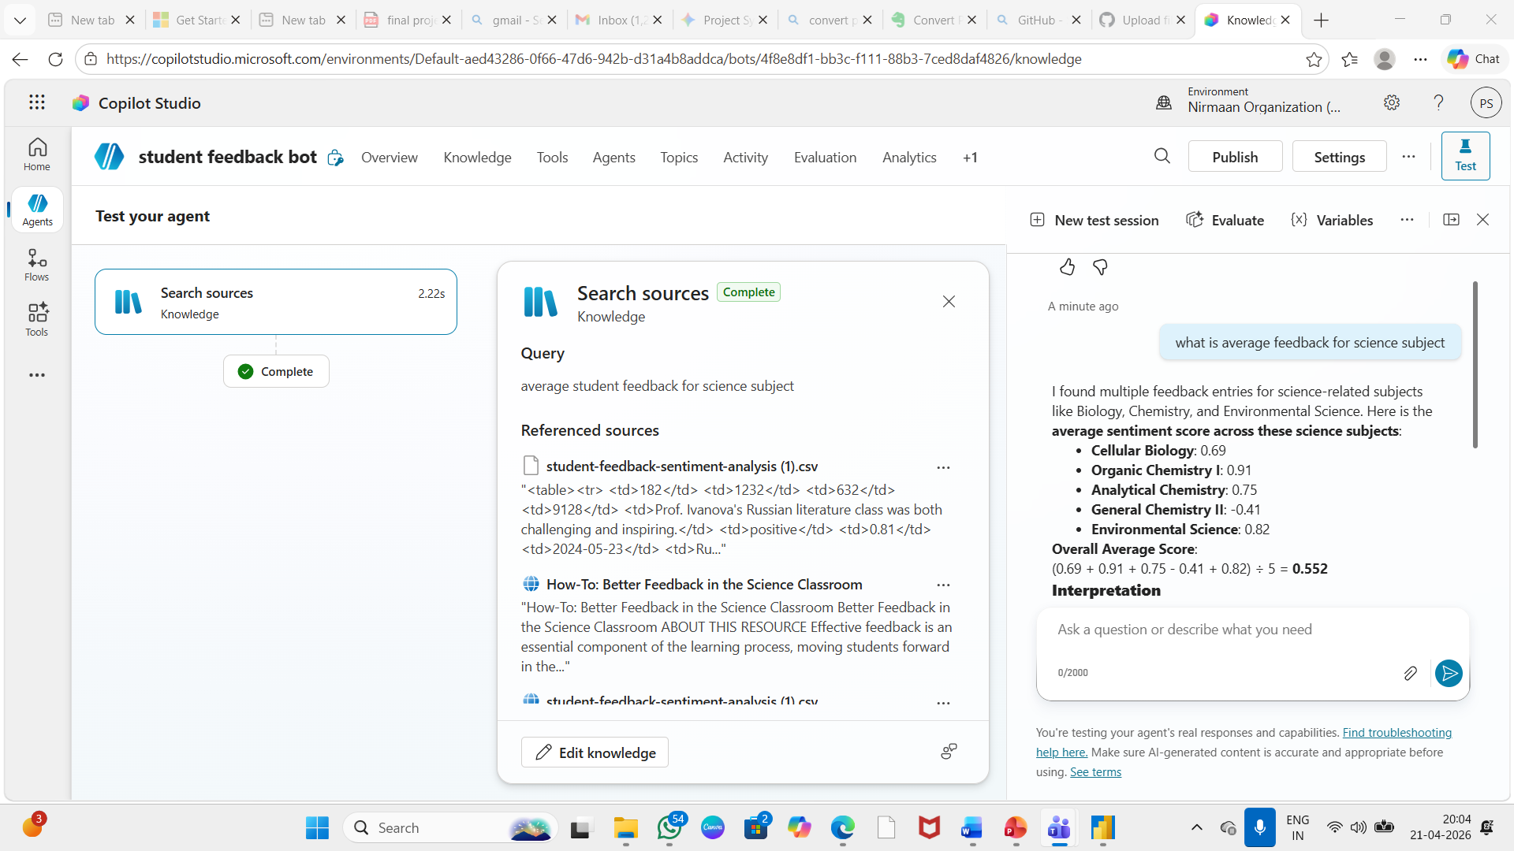
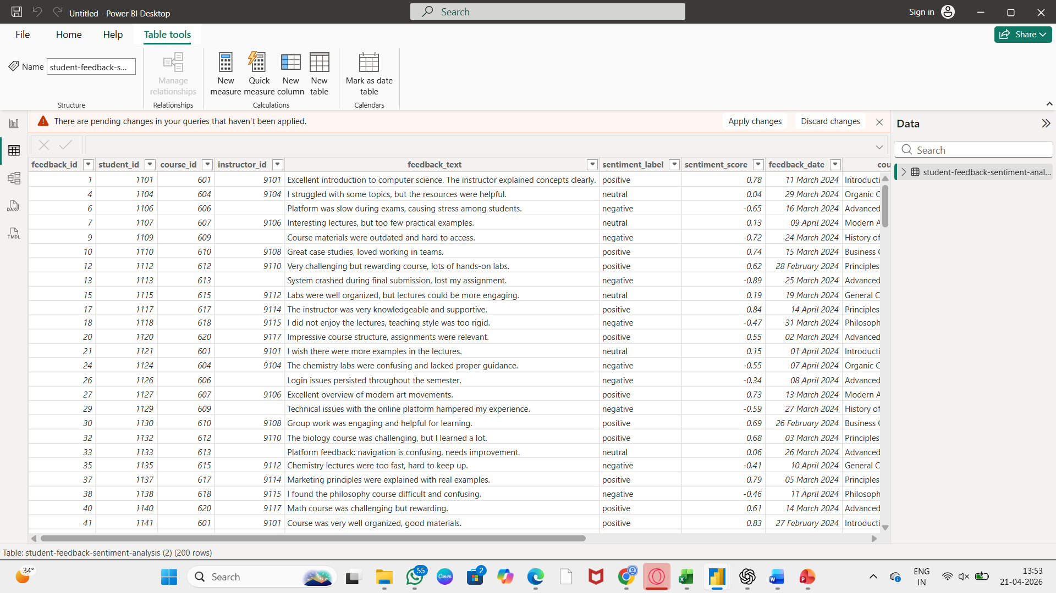
Live Demo of Project
Here's the list of some demo screenshots / features of the project:
Demo 1
Student Feedback Sentiment Analysis
This demo showcases student feedback sentiment analysis using AI and Power BI. The uploaded feedback dataset is analyzed to classify comments into positive, negative, and neutral sentiments. The dashboard displays sentiment distribution charts, overall satisfaction score, and key feedback themes.
AI Chatbot using Copilot
This demo shows an AI chatbot built using Microsoft Copilot Studio to analyze student feedback. Users can ask questions and get instant insights on sentiment, faculty performance, and improvement areas.
It demonstrates how AI automates analysis and supports quick, data-driven decisions.
Demo 2
Faculty Performance Comparison Dashboard
This demo presents a faculty performance comparison dashboard created using Power BI. The system analyzes student feedback across multiple faculty members and compares ratings, sentiment scores, and key feedback themes.
Demo 3

Slide 8
Video of Project Demo
[https://your-project-demo-link.com]
▶
[Insert your project demo video.
You can embed a video your live project.]

Slide 9

Conclusion
Edu Pulse AI successfully converts student feedback into actionable insights using AI and Power BI. It performs sentiment analysis, generates faculty recommendations, and provides interactive dashboards.
The project improves understanding of student satisfaction, identifies improvement areas, and supports data-driven decision-making. It offers a scalable solution for enhancing teaching quality and institutional performance.
CONCLUSION

Slide 10

Future Scope
The Edu Pulse AI project can be further enhanced by integrating real-time feedback collection through mobile apps and online portals. Future improvements may include advanced NLP models for better multilingual sentiment analysis and sarcasm detection to improve accuracy.
The system can also be scaled to integrate with Learning Management Systems (LMS) and institutional databases for automated data updates. Additional features such as predictive analytics can help identify at-risk students and forecast teaching effectiveness.
Further enhancements may include automated report generation, voice-based feedback analysis, and cross-institutional benchmarking dashboard.

Slide 11
Thank You
AICW Fellowship | Faculty Project Presentation 2026
LinkedIn | Edunet Foundation

